Slide 1
Associated learning
Hung-Hsuan Chen

Slide 2
Review: backpropagation
A method to efficiently compute the gradient of the loss with respect to the parameters
Chain rule
Layer-wise update

Slide 3
Backward locking
Since the parameters in a DNN are updated in a layer-wise fashion:
Updating the weights of one layer locks the weight updates in the other layers
Challenging to apply parallel computing or a pipeline structure to update the weights in different layers simultaneously

Slide 4
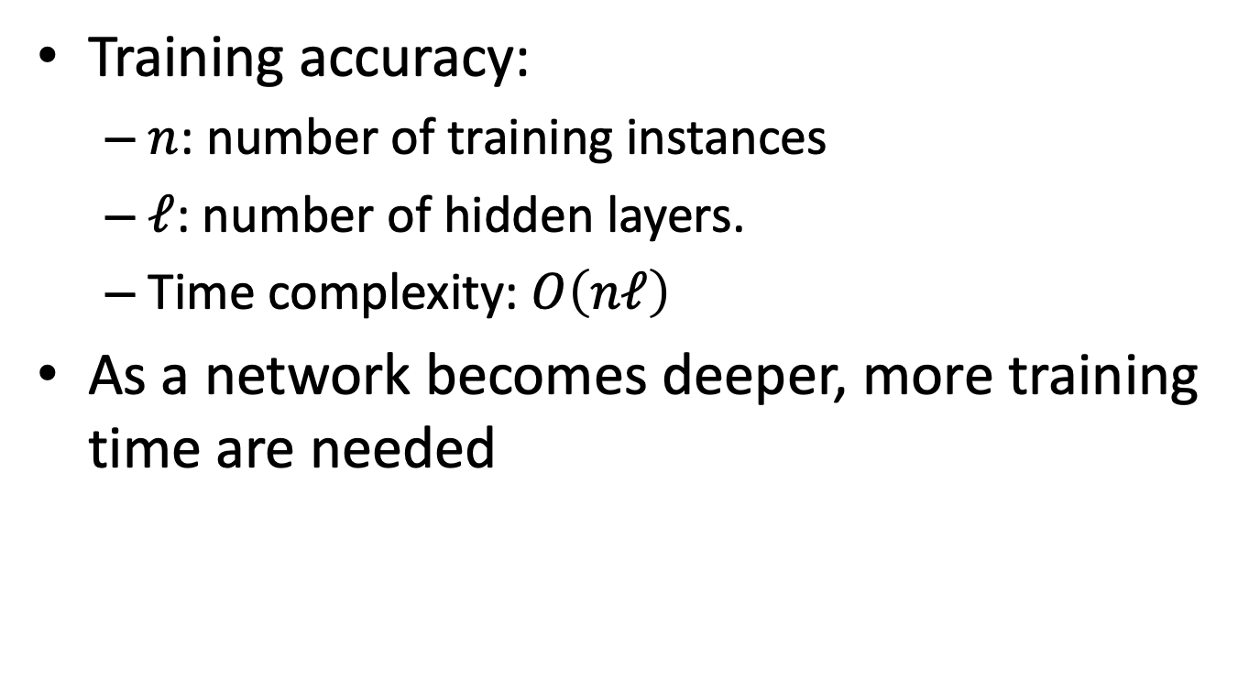
Time complexity of training a DNN
Training accuracy:
$n$: number of training instances
$ℓ$: number of hidden layers.
Time complexity: $O\left(nℓ\right)$
As a network becomes deeper, more training time are needed

Slide 5
Can we “parallelize” the training?
Two types of parallelizations
Type 1
Compute SGD at different cores using different subsamples
Average the gradients of different cores, and apply parameter updates
Type 2
Update parameters of different layers simultaneously
Seems more challenging
We focus on this type

Slide 6
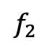
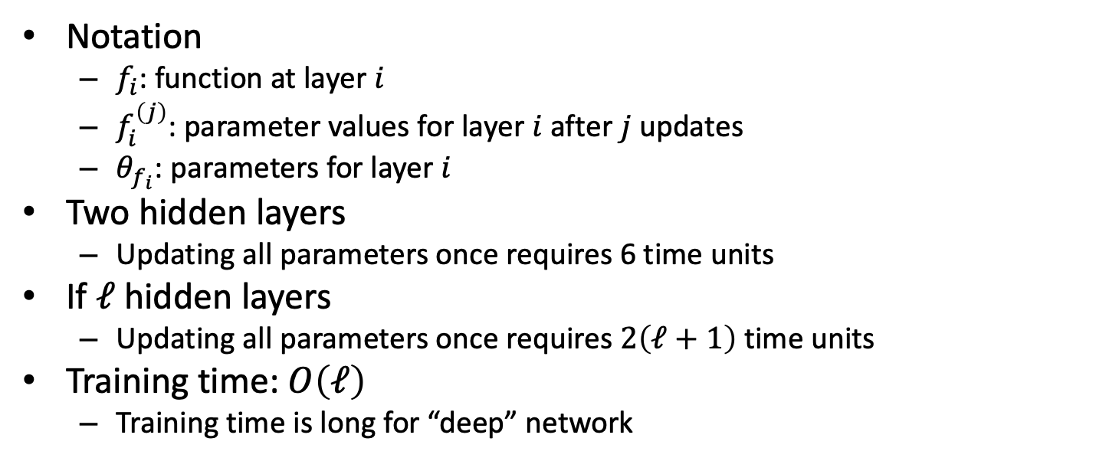
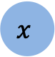
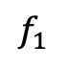
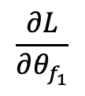
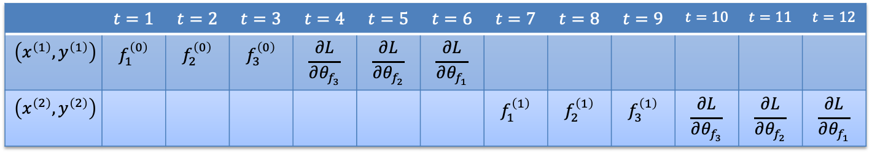

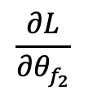
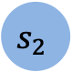
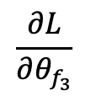
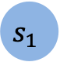
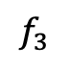
Naively using SGD and backpropagation
$$f_{1}$$
$$f_{2}$$
$$f_{3}$$
$$x$$
$$s_{1}$$
$$s_{2}$$
$$y$$
$$\frac{∂L}{∂θ_{f_{1}}}$$
$$\frac{∂L}{∂θ_{f_{2}}}$$
$$\frac{∂L}{∂θ_{f_{3}}}$$
 | $$t=1$$ | $$t=2$$ | $$t=3$$ | $$t=4$$ | $$t=5$$ | $$t=6$$ | $$t=7$$ | $$t=8$$ | $$t=9$$ | $$t=10$$ | $$t=11$$ | $$t=12$$
$$\left(x^{\left(1\right)},y^{\left(1\right)}\right)$$ | $$f_{1}^{\left(0\right)}$$ | $$f_{2}^{\left(0\right)}$$ | $$f_{3}^{\left(0\right)}$$ | $$\frac{∂L}{∂θ_{f_{3}}}$$ | $$\frac{∂L}{∂θ_{f_{2}}}$$ | $$\frac{∂L}{∂θ_{f_{1}}}$$
$$\left(x^{\left(2\right)},y^{\left(2\right)}\right)$$ |  |  |  |  |  |  | $$f_{1}^{\left(1\right)}$$ | $$f_{2}^{\left(1\right)}$$ | $$f_{3}^{\left(1\right)}$$ | $$\frac{∂L}{∂θ_{f_{3}}}$$ | $$\frac{∂L}{∂θ_{f_{2}}}$$ | $$\frac{∂L}{∂θ_{f_{1}}}$$
Notation
$f_{i}$: function at layer $i$
$f_{i}^{\left(j\right)}$: parameter values for layer $i$ after $j$ updates
$θ_{f_{i}}$: parameters for layer $i$
Two hidden layers
Updating all parameters once requires 6 time units
If $ℓ$ hidden layers
Updating all parameters once requires $2\left(ℓ+1\right)$ time units
Training time: $O\left(ℓ\right)$
Training time is long for “deep” network

Slide 7
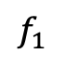
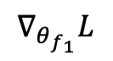
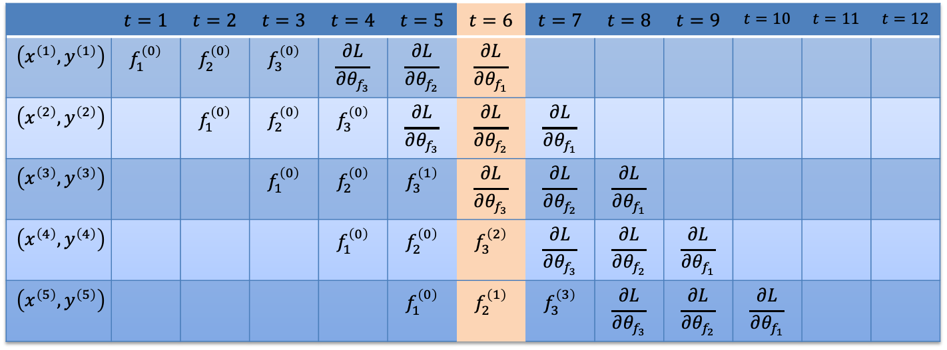

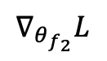
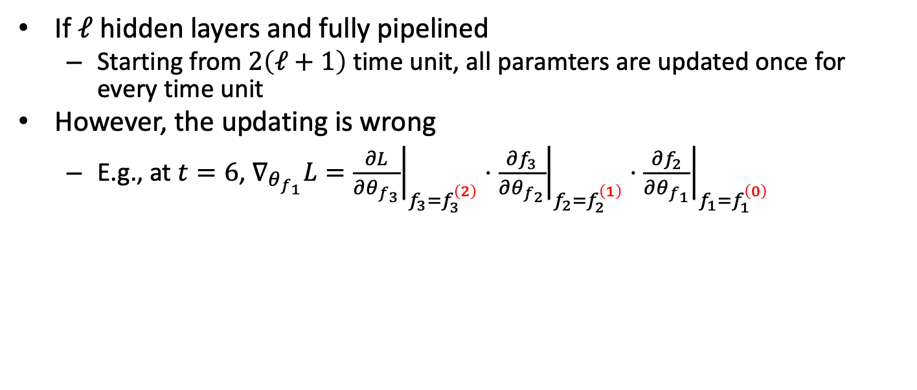
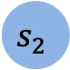
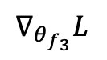
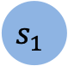
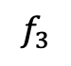

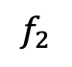
Add pipeline directly
$$f_{1}$$
$$f_{2}$$
$$f_{3}$$
$$x$$
$$s_{1}$$
$$s_{2}$$
$$y$$
$$∇_{θ_{f_{1}}}L$$
$$∇_{θ_{f_{2}}}L$$
$$∇_{θ_{f_{3}}}L$$
 | $$t=1$$ | $$t=2$$ | $$t=3$$ | $$t=4$$ | $$t=5$$ | $$t=6$$ | $$t=7$$ | $$t=8$$ | $$t=9$$ | $$t=10$$ | $$t=11$$ | $$t=12$$
$$\left(x^{\left(1\right)},y^{\left(1\right)}\right)$$ | $$f_{1}^{\left(0\right)}$$ | $$f_{2}^{\left(0\right)}$$ | $$f_{3}^{\left(0\right)}$$ | $$\frac{∂L}{∂θ_{f_{3}}}$$ | $$\frac{∂L}{∂θ_{f_{2}}}$$ | $$\frac{∂L}{∂θ_{f_{1}}}$$
$$\left(x^{\left(2\right)},y^{\left(2\right)}\right)$$ |  | $$f_{1}^{\left(0\right)}$$ | $$f_{2}^{\left(0\right)}$$ | $$f_{3}^{\left(0\right)}$$ | $$\frac{∂L}{∂θ_{f_{3}}}$$ | $$\frac{∂L}{∂θ_{f_{2}}}$$ | $$\frac{∂L}{∂θ_{f_{1}}}$$
$$\left(x^{\left(3\right)},y^{\left(3\right)}\right)$$ |  |  | $$f_{1}^{\left(0\right)}$$ | $$f_{2}^{\left(0\right)}$$ | $$f_{3}^{\left(1\right)}$$ | $$\frac{∂L}{∂θ_{f_{3}}}$$ | $$\frac{∂L}{∂θ_{f_{2}}}$$ | $$\frac{∂L}{∂θ_{f_{1}}}$$
$$\left(x^{\left(4\right)},y^{\left(4\right)}\right)$$ |  |  |  | $$f_{1}^{\left(0\right)}$$ | $$f_{2}^{\left(0\right)}$$ | $$f_{3}^{\left(2\right)}$$ | $$\frac{∂L}{∂θ_{f_{3}}}$$ | $$\frac{∂L}{∂θ_{f_{2}}}$$ | $$\frac{∂L}{∂θ_{f_{1}}}$$
$$\left(x^{\left(5\right)},y^{\left(5\right)}\right)$$ |  |  |  |  | $$f_{1}^{\left(0\right)}$$ | $$f_{2}^{\left(1\right)}$$ | $$f_{3}^{\left(3\right)}$$ | $$\frac{∂L}{∂θ_{f_{3}}}$$ | $$\frac{∂L}{∂θ_{f_{2}}}$$ | $$\frac{∂L}{∂θ_{f_{1}}}$$
If $ℓ$ hidden layers and fully pipelined
Starting from $2\left(ℓ+1\right)$ time unit, all paramters are updated once for every time unit
However, the updating is wrong
E.g., at $t=6$, $∇_{θ_{f_{1}}}L={\left.\frac{∂L}{∂θ_{f_{3}}}\right|}_{f_{3}=f_{3}^{\left(2\right)}}⋅{\left.\frac{∂f_{3}}{∂θ_{f_{2}}}\right|}_{f_{2}=f_{2}^{\left(1\right)}}⋅{\left.\frac{∂f_{2}}{∂θ_{f_{1}}}\right|}_{f_{1}=f_{1}^{\left(0\right)}}$

Slide 8
How to pipeline?
Gpipe
Yanping Huang et al.
NeurIPS 2019
Associated learning
Yu-Wei Kao and Hung-Hsuan Chen
Neural Computation 33(1) 2021.

Slide 9
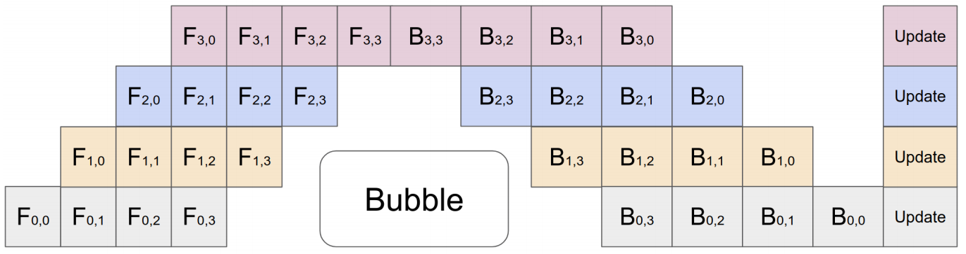
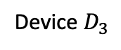
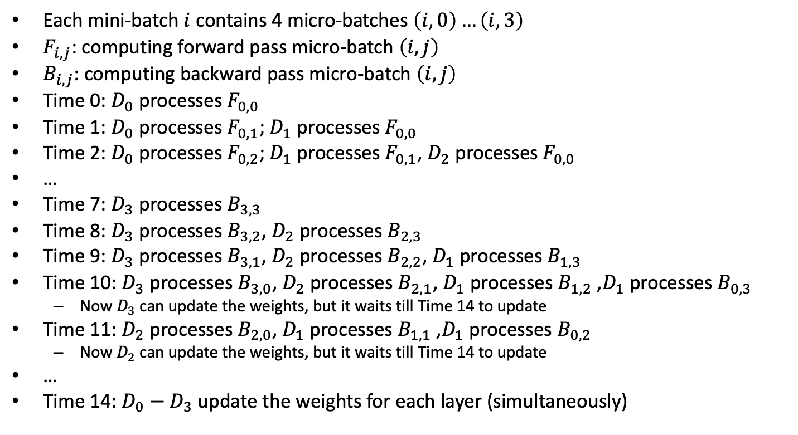
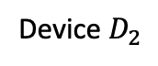
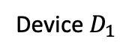
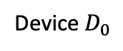
Gpipe
Device $D_{3}$
Device $D_{2}$
Device $D_{1}$
Device $D_{0}$
Each mini-batch $i$ contains 4 micro-batches $\left(i,0\right)…\left(i,3\right)$
$F_{i,j}$: computing forward pass micro-batch $\left(i,j\right)$
$B_{i,j}$: computing backward pass micro-batch $\left(i,j\right)$
Time 0: $D_{0}$ processes $F_{0,0}$
Time 1: $D_{0}$ processes $F_{0,1}$; $D_{1}$ processes $F_{0,0}$
Time 2: $D_{0}$ processes $F_{0,2}$; $D_{1}$ processes $F_{0,1}$, $D_{2}$ processes $F_{0,0}$
…
Time 7: $D_{3}$ processes $B_{3,3}$
Time 8: $D_{3}$ processes $B_{3,2}$, $D_{2}$ processes $B_{2,3}$
Time 9: $D_{3}$ processes $B_{3,1}$, $D_{2}$ processes $B_{2,2}$, $D_{1}$ processes $B_{1,3}$
Time 10: $D_{3}$ processes $B_{3,0}$, $D_{2}$ processes $B_{2,1}$, $D_{1}$ processes $B_{1,2}$ ,$D_{1}$ processes $B_{0,3}$
Now $D_{3}$ can update the weights, but it waits till Time 14 to update
Time 11: $D_{2}$ processes $B_{2,0}$, $D_{1}$ processes $B_{1,1}$ ,$D_{1}$ processes $B_{0,2}$
Now $D_{2}$ can update the weights, but it waits till Time 14 to update
…
Time 14: $D_{0}−D_{3}$ update the weights for each layer (simultaneously)

Slide 10
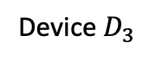
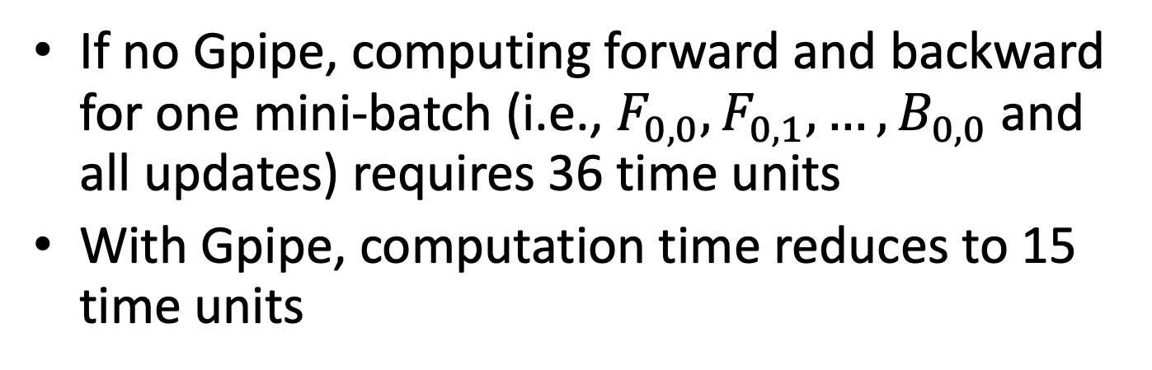
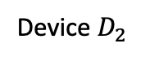
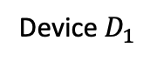
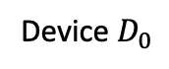
Gpipe
Device $D_{3}$
Device $D_{2}$
Device $D_{1}$
Device $D_{0}$
If no Gpipe, computing forward and backward for one mini-batch (i.e., $F_{0,0}, F_{0,1},…,B_{0,0}$ and all updates) requires 36 time units
With Gpipe, computation time reduces to 15 time units

Slide 11
Gpipe
First mini-batch (4 micro-batches)
Second mini-batch (4 micro-batches)
Chain rule works as normal
Reduce training time by pipelining
However, still need to inser bubble for each mini-batch

Slide 12
Associated learning (AL)
Modularize a DNN into smaller components
Each small component has a local objective
Local objectives are mutually indenpdent
AL fully pipelines the forward and backward process, because the objectives are mutually independent

Slide 13
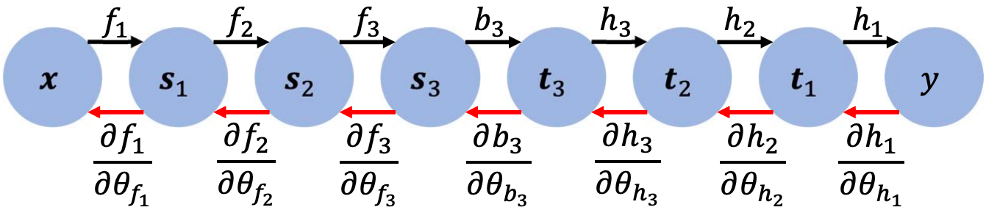
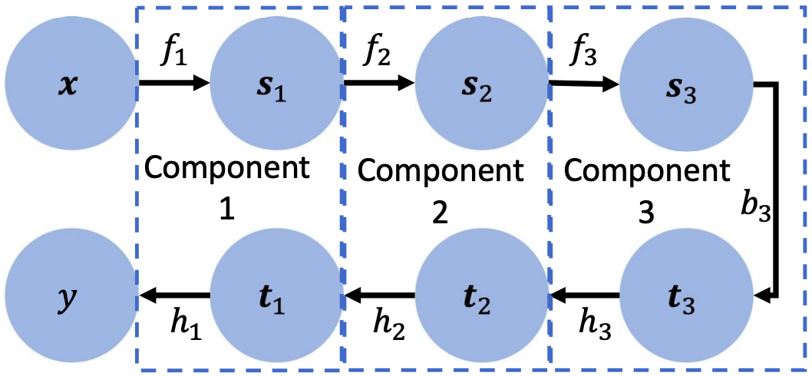
Modularize DNN (e.g., 6 hidden layers)

Slide 14
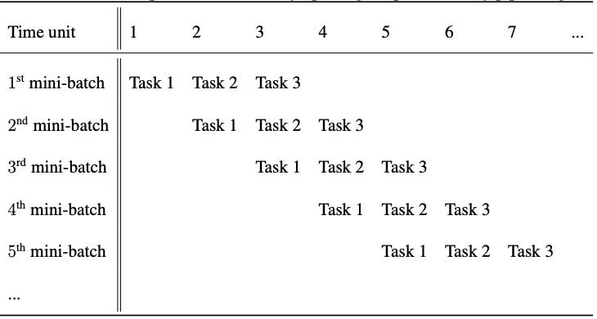
How to pipeline

Slide 15
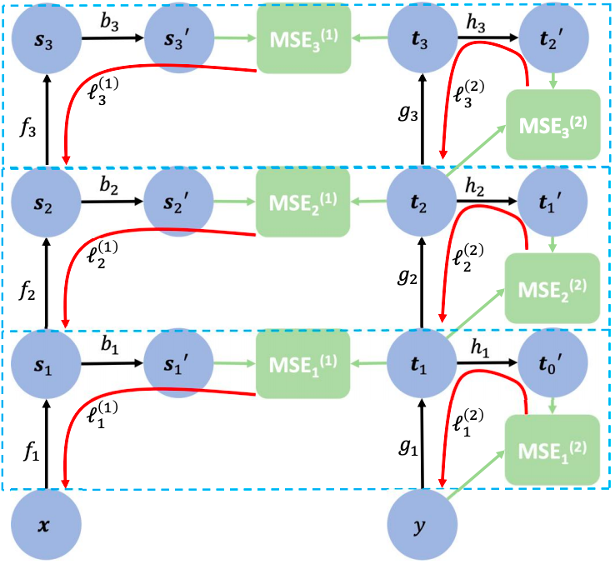
Associated learning – procedure
Black arrow: forward
Red arrow: backward gradient flow
Green arrow: connect the variables that should be compared to minimize their associated distance

Slide 16
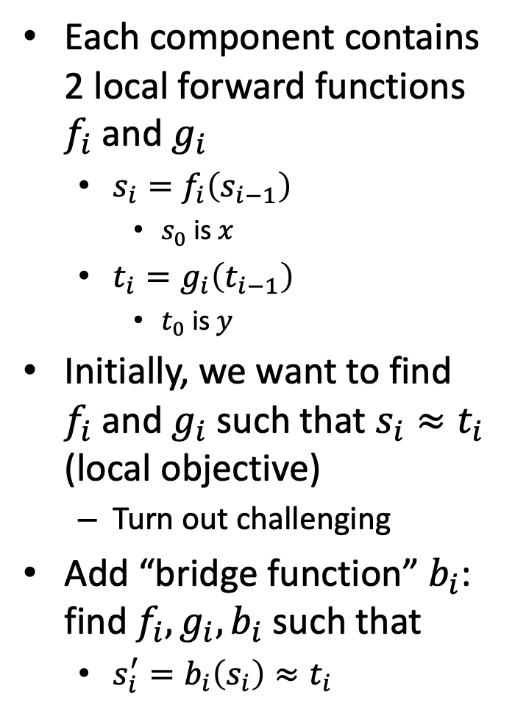
Associated learning – procedure
Each component contains 2 local forward functions $f_{i}$ and $g_{i}$
$s_{i}=f_{i}\left(s_{i−1}\right)$
$s_{0}$ is $x$
$t_{i}=g_{i}\left(t_{i−1}\right)$
$t_{0}$ is $y$
Initially, we want to find $f_{i}$ and $g_{i}$ such that $s_{i}≈t_{i}$ (local objective)
Turn out challenging
Add “bridge function” $b_{i}$: find $f_{i}, g_{i}, b_{i}$ such that
$s_{i}^{′}=b_{i}\left(s_{i}\right)≈t_{i}$

Slide 17
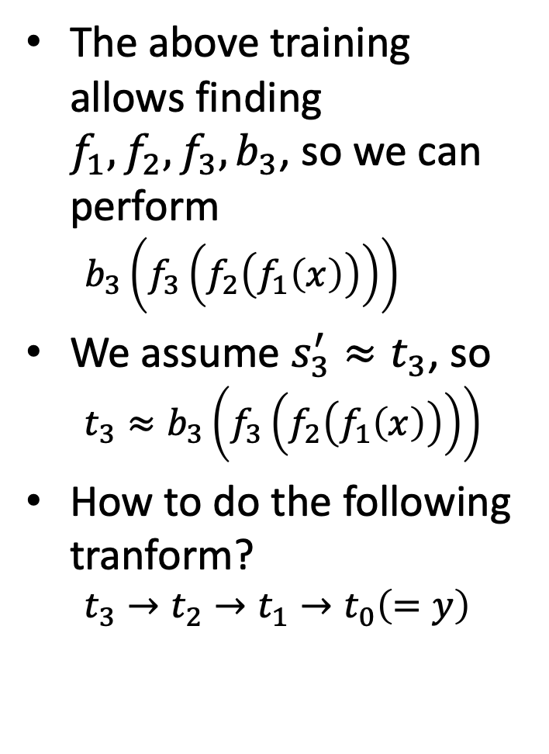
Associated learning – procedure
The above training allows finding $f_{1}, f_{2}, f_{3}, b_{3}$, so we can perform
$$b_{3}\left(f_{3}\left(f_{2}\left(f_{1}\left(x\right)\right)\right)\right)$$
We assume $s_{3}^{′}≈t_{3}$, so
$$t_{3}≈b_{3}\left(f_{3}\left(f_{2}\left(f_{1}\left(x\right)\right)\right)\right)$$
How to do the following tranform?
$$t_{3}→t_{2}→t_{1}→t_{0}\left(=y\right)$$

Slide 18
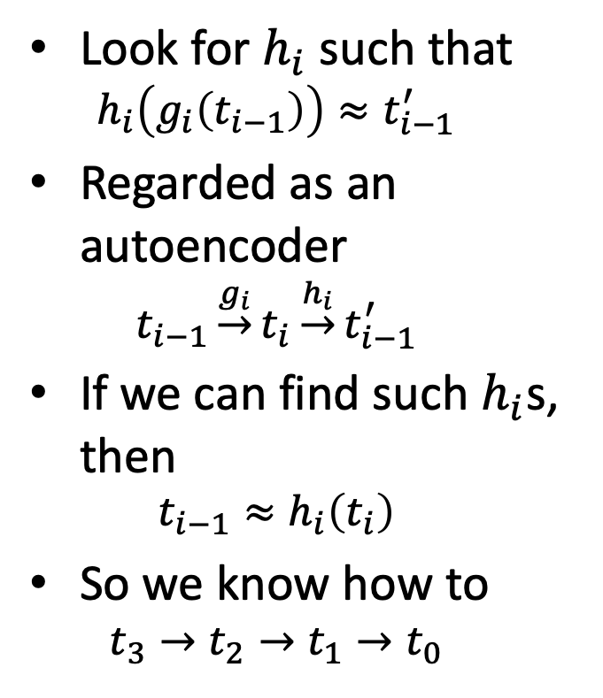
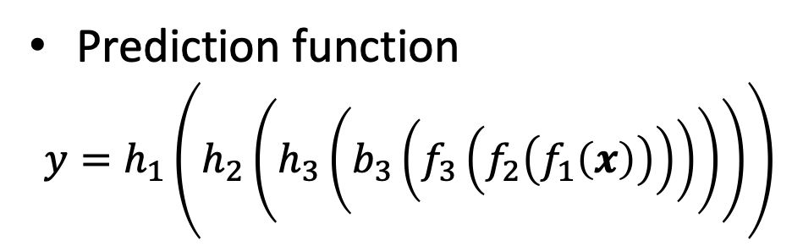
Associated learning – procedure
Look for $h_{i}$ such that
$$h_{i}\left(g_{i}\left(t_{i−1}\right)\right)≈t_{i−1}^{′}$$
Regarded as an autoencoder
$$t_{i−1}\underset{→}{g_{i}}t_{i}\underset{→}{h_{i}}t_{i−1}^{′}$$
If we can find such $h_{i}$s, then
$$t_{i−1}≈h_{i}\left(t_{i}\right)$$
So we know how to
$$t_{3}→t_{2}→t_{1}→t_{0}$$
Prediction function
$$y=h_{1}\left(h_{2}\left(h_{3}\left(b_{3}\left(f_{3}\left(f_{2}\left(f_{1}\left(x\right)\right)\right)\right)\right)\right)\right)$$

Slide 19
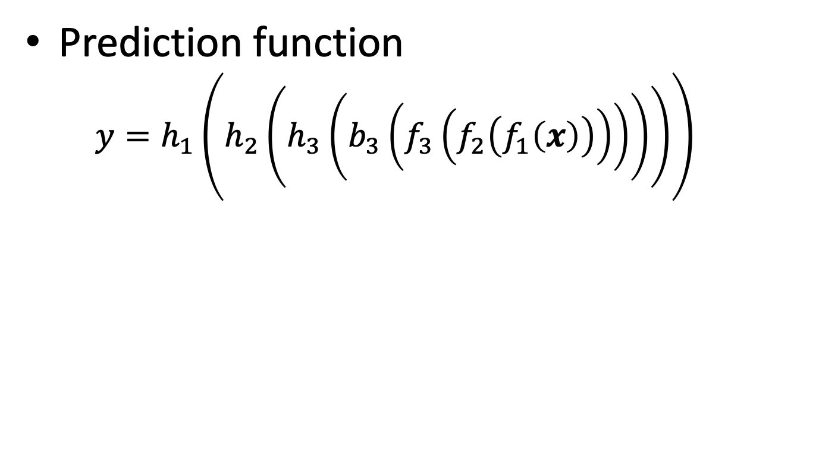
Associated learning
Prediction function
$$y=h_{1}\left(h_{2}\left(h_{3}\left(b_{3}\left(f_{3}\left(f_{2}\left(f_{1}\left(x\right)\right)\right)\right)\right)\right)\right)$$
Forward function
backward function
The last bridge function

Slide 20
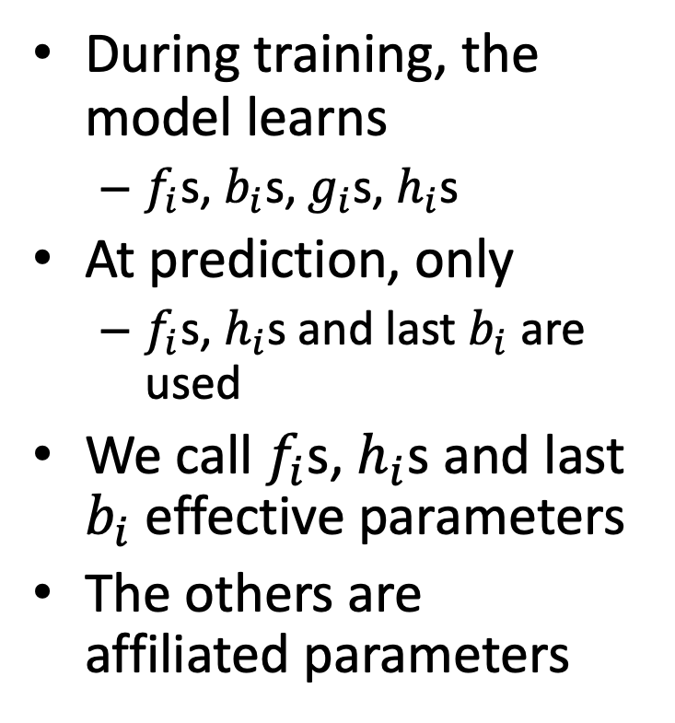
Effective and affiliated parameters
During training, the model learns
$f_{i}$s, $b_{i}$s, $g_{i}$s, $h_{i}$s
At prediction, only
$f_{i}$s, $h_{i}$s and last $b_{i}$ are used
We call $f_{i}$s, $h_{i}$s and last $b_{i}$ effective parameters
The others are affiliated parameters

Slide 21
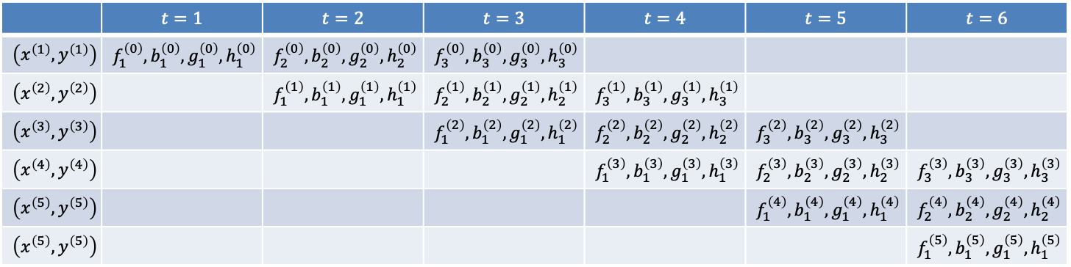
Associated learning and pipeline
 | $$t=1$$ | $$t=2$$ | $$t=3$$ | $$t=4$$ | $$t=5$$ | $$t=6$$
$$\left(x^{\left(1\right)},y^{\left(1\right)}\right)$$ | $$f_{1}^{\left(0\right)},b_{1}^{\left(0\right)},g_{1}^{\left(0\right)},h_{1}^{\left(0\right)}$$ | $$f_{2}^{\left(0\right)},b_{2}^{\left(0\right)},g_{2}^{\left(0\right)},h_{2}^{\left(0\right)}$$ | $$f_{3}^{\left(0\right)},b_{3}^{\left(0\right)},g_{3}^{\left(0\right)},h_{3}^{\left(0\right)}$$
$$\left(x^{\left(2\right)},y^{\left(2\right)}\right)$$ |  | $$f_{1}^{\left(1\right)},b_{1}^{\left(1\right)},g_{1}^{\left(1\right)},h_{1}^{\left(1\right)}$$ | $$f_{2}^{\left(1\right)},b_{2}^{\left(1\right)},g_{2}^{\left(1\right)},h_{2}^{\left(1\right)}$$ | $$f_{3}^{\left(1\right)},b_{3}^{\left(1\right)},g_{3}^{\left(1\right)},h_{3}^{\left(1\right)}$$
$$\left(x^{\left(3\right)},y^{\left(3\right)}\right)$$ |  |  | $$f_{1}^{\left(2\right)},b_{1}^{\left(2\right)},g_{1}^{\left(2\right)},h_{1}^{\left(2\right)}$$ | $$f_{2}^{\left(2\right)},b_{2}^{\left(2\right)},g_{2}^{\left(2\right)},h_{2}^{\left(2\right)}$$ | $$f_{3}^{\left(2\right)},b_{3}^{\left(2\right)},g_{3}^{\left(2\right)},h_{3}^{\left(2\right)}$$
$$\left(x^{\left(4\right)},y^{\left(4\right)}\right)$$ |  |  |  | $$f_{1}^{\left(3\right)},b_{1}^{\left(3\right)},g_{1}^{\left(3\right)},h_{1}^{\left(3\right)}$$ | $$f_{2}^{\left(3\right)},b_{2}^{\left(3\right)},g_{2}^{\left(3\right)},h_{2}^{\left(3\right)}$$ | $$f_{3}^{\left(3\right)},b_{3}^{\left(3\right)},g_{3}^{\left(3\right)},h_{3}^{\left(3\right)}$$
$$\left(x^{\left(5\right)},y^{\left(5\right)}\right)$$ |  |  |  |  | $$f_{1}^{\left(4\right)},b_{1}^{\left(4\right)},g_{1}^{\left(4\right)},h_{1}^{\left(4\right)}$$ | $$f_{2}^{\left(4\right)},b_{2}^{\left(4\right)},g_{2}^{\left(4\right)},h_{2}^{\left(4\right)}$$
$$\left(x^{\left(5\right)},y^{\left(5\right)}\right)$$ |  |  |  |  |  | $$f_{1}^{\left(5\right)},b_{1}^{\left(5\right)},g_{1}^{\left(5\right)},h_{1}^{\left(5\right)}$$

Slide 22
Experimental settings
Dataset
MNIST
CIFAR-10
CIFAR-100
NN structure
MLP
Vanilla CNN
VGG Net
ResNet-20
ResNet-32

Slide 23
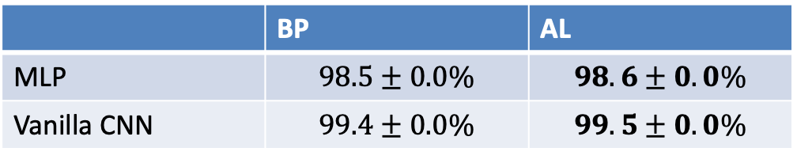
Experimental results on MNIST
 | BP | AL
MLP | $$98.5±0.0\%$$ | $$98.6±0.0\%$$
Vanilla CNN | $$99.4±0.0\%$$ | $$99.5±0.0\%$$
MLP: 5 hidden layers
1024 x 1024 x 5120 x 1024 x 1024
Vanilla CNN: 13 hidden layers
First four layers: (3 x 3 x 32) kernels
Next four layers: (3 x 3 x 64) kernels
Last five layers: fully connected 1280 x 256 x 256 x 256 x 256
We didn’t try more complex networks, as MLP and Vanilla CNN are extremely good

Slide 24
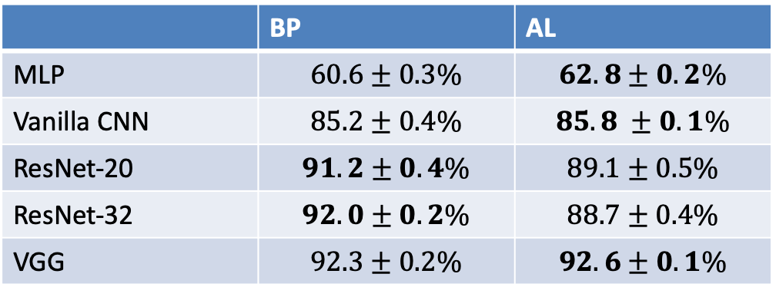
Experimental results on CIFAR-10
 | BP | AL
MLP | $$60.6±0.3\%$$ | $$62.8±0.2\%$$
Vanilla CNN | $$85.2±0.4\%$$ | $$85.8 ±0.1\%$$
ResNet-20 | $$91.2±0.4\%$$ | $$89.1±0.5\%$$
ResNet-32 | $$92.0±0.2\%$$ | $$88.7±0.4\%$$
VGG | $$92.3±0.2\%$$ | $$92.6±0.1\%$$

Slide 25
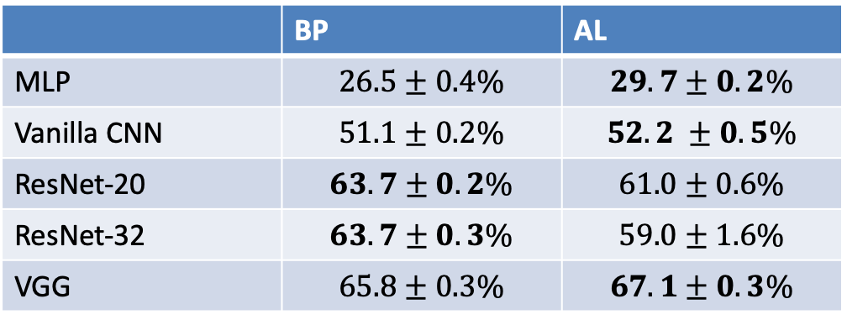
Experimental results on CIFAR-100
 | BP | AL
MLP | $$26.5±0.4\%$$ | $$29.7±0.2\%$$
Vanilla CNN | $$51.1±0.2\%$$ | $$52.2 ±0.5\%$$
ResNet-20 | $$63.7±0.2\%$$ | $$61.0±0.6\%$$
ResNet-32 | $$63.7±0.3\%$$ | $$59.0±1.6\%$$
VGG | $$65.8±0.3\%$$ | $$67.1±0.3\%$$

Slide 26
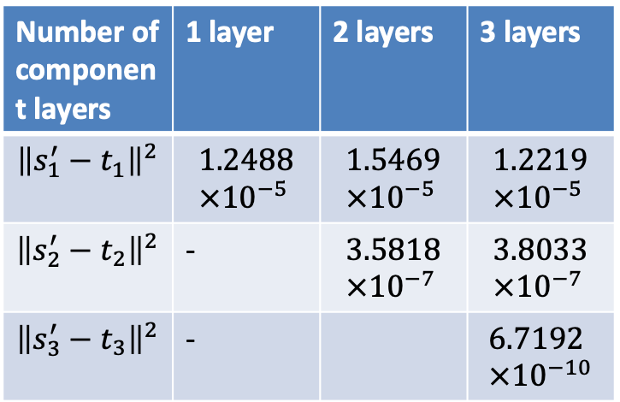
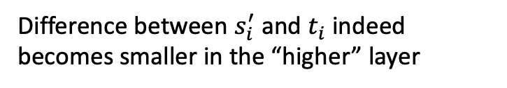
Associated loss at different layers on MNIST after 200 epochs
Number of component layers | 1 layer | 2 layers | 3 layers
$${\left\|s_{1}^{′}−t_{1}\right\|}^{2}$$ | $$1.2488×{10}^{−5}$$ | $$1.5469×{10}^{−5}$$ | $$1.2219×{10}^{−5}$$
$${\left\|s_{2}^{′}−t_{2}\right\|}^{2}$$ | - | $$3.5818×{10}^{−7}$$ | $$3.8033×{10}^{−7}$$
$${\left\|s_{3}^{′}−t_{3}\right\|}^{2}$$ | - |  | $$6.7192×{10}^{−10}$$
Difference between $s_{i}^{′}$ and $t_{i}$ indeed becomes smaller in the “higher” layer

Slide 27
Number of layers vs training/test accuracies
Number of component layers | 1 layer | 2 layers | 3 layers
Training accuracy | 1.0 | 1.0 | 1.0
Test accuracy | 0.9849 | 0.9860 | 0.9871
Increasing layers increases test accuracies

Slide 28
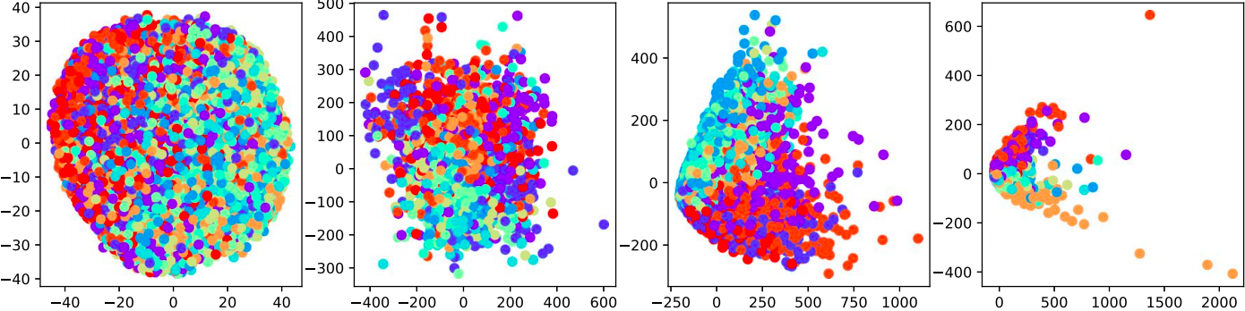

t-SNE visualization of MLP on CIFAR-10
Raw data, 2nd layer, 4th layer, and output layer when training by BP
Raw data, 2nd layer, 4th layer, and output layer when training by AL

Slide 29


t-SNE visualization of CNN on CIFAR-10
Raw data, 4th layer, 8th layer, and 12th layer when training by BP
Raw data, 4th layer, 8th layer, and 12th layer when training by AL

Slide 30

Inter- and intra-distances and ratios of the two

Slide 31
Summary
Propose a method , AL, to decompose end-to-end backpropagation into many short gradient flows
Fully pipelined the learning
Experiments of multiple network structures on multiple datsets show that AL is comparable (and sometimes better) than BP

Slide 32
Discussion
We implemented AL, but we didn’t implement a “pipelined” AL
How to implement pipeline in Tensorflow or PyTorch?
Most components in AL do not receive messages directly from the target, but AL performs comparable to BP.
This is a nice surprise, but we don’t know why
If we know why AL works, perhaps we can design better network structure?
Does AL converge? Does the loss function converge to minima?
Experiments on other (larger) datasets?
If you are interested in any of the above topics, please let me know

Slide 33
More information
Associated Learning: Decomposing End-to-End Backpropagation Based on Autoencoders and Target Propagation
Yu-Wei Kao (高聿緯), Hung-Hsuan Chen (陳弘軒)
MIT Neural Computation 33(1), 2021
https://arxiv.org/pdf/1906.05560.pdf

Slide 34
Quiz
What is backward locking?
Compare pipeline and parallel computing
What is the key concept of associated learning?

